Slide 1

We will begin the quiz soon!

Slide 2
W4111 – Introduction to Databases Section 002, Spring 2021 Lecture 7: ER, Apps, SQL, Projects
© Donald F. Ferguson, 2021

Slide 3
W4111 – Introduction to Databases Section 002, Spring 2021 Lecture 7: ER, Apps, SQL, Projects
We will start in a couple of minutes.
© Donald F. Ferguson, 2021

Slide 4
W4111 – Introduction to Databases Section 002, Spring 2021 Lecture 7: ER, Apps, SQL, Projects
We will start Ohs in a couple of minutes.
© Donald F. Ferguson, 2021

Slide 5

Contents and Agenda
5 | COMS W4111_002_2021_1: Lecture 7: ER, Apps, SQL, Projects © Donald F. Ferguson, 2021

Slide 6
Contents
Questions, comments, discussion.

Slide 7
HW3 and HW4 – Incremental Project My Example
7 | COMS W4111_002_2021_1: Lecture 7: ER, Apps, SQL, Projects © Donald F. Ferguson, 2021

Slide 8

My HW3 and HW4 Project Concept
8 | COMS W4111_002_2021_1: Lecture 7: ER, Apps, SQL, Projects © Donald F. Ferguson, 2021

Slide 9
Pretend to Play Fantasy Baseball
My example projects for the two tracks will be a simple fantasy baseball solution.
“Fantasy baseball is a game in which people manage rosters of league baseball players, either online or in a physical location, using fictional fantasy baseball team names. The participants compete against one another using those players' real-life statistics to score points.”
My solution will have two subsystems:
Analysis system:
Read only data that enables people to select players based on performance, and to estimate the performance of their fantasy team.
Event based update system that changes analysis data based on new data.
Operational system that manages create, retrieve update, delete, etc. of their fantasy teams and leagues.
INSERT, UPDATE, DELETE primarily apply to the operational system.

Slide 10

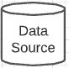
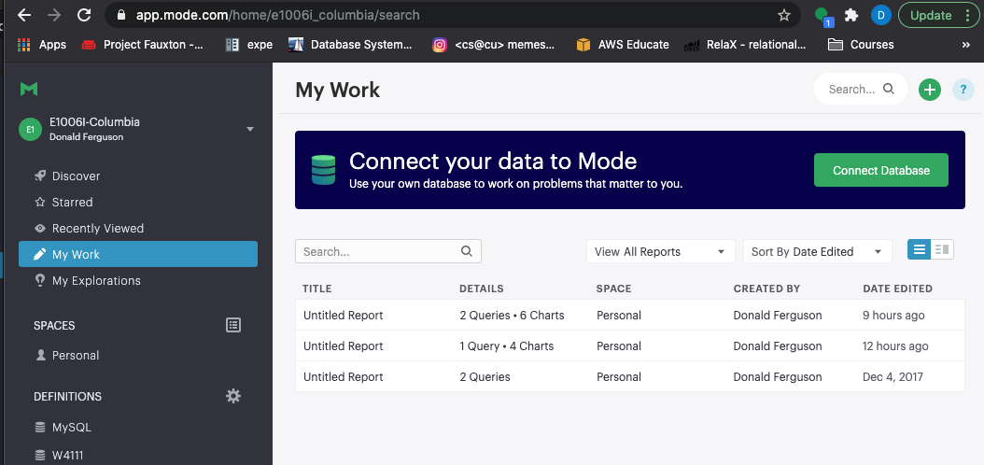

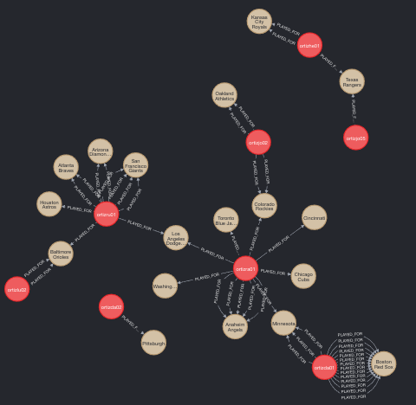
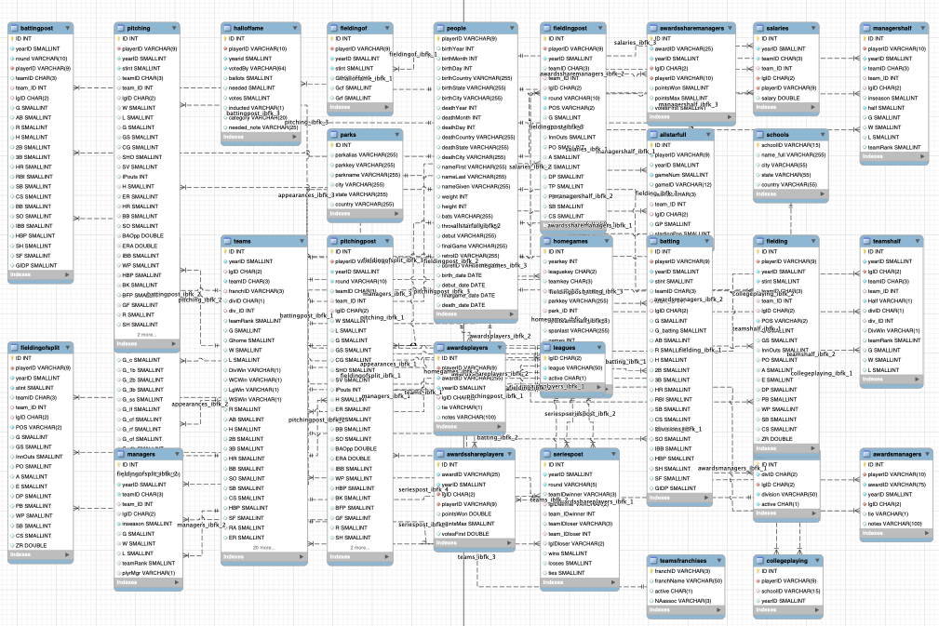
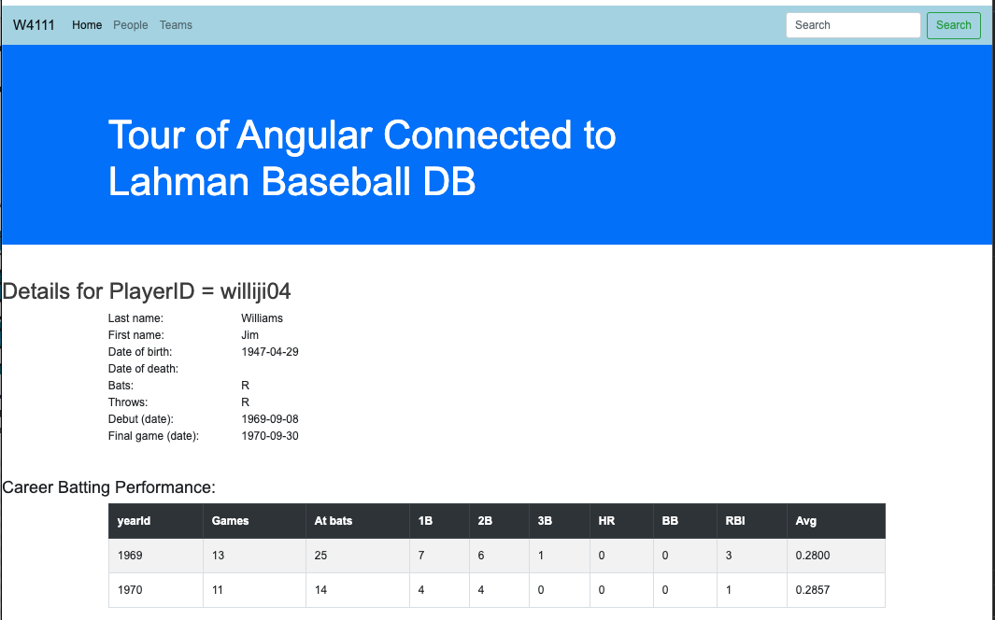
Target Application/Project(s) – Reminder (Lecture 1)
Data Insight Service
Data Lake
Web Application
Social Network Service
DB Access Service
Core Data Service
Comment Discussion Service

Slide 11
Target Application/Project – Reminder (Lecture 1)
That diagram was pretty confusing.
Basically, what it comes down to is that there will be major subsystems:
Interactive web application for viewing, navigating and updating data. The updates have to preserve semantic constraints and correctness.
A decision support warehouse/lake that allows us to explore data and get insights.
Programming and non-programming tracks will get experience with both, but
Non-programming track focuses on data engineering needed to produce (2).
Programming track will focus on (1).
The example that I will use is fantasy baseball because it covers both aspects, and there is a lot of interesting data available.
You will have some freedom on the data models and scenarios you choose.

Slide 12
Operational System (Web Application)
12 | COMS W4111_002_2021_1: Lecture 7: ER, Apps, SQL, Projects © Donald F. Ferguson, 2021

Slide 13
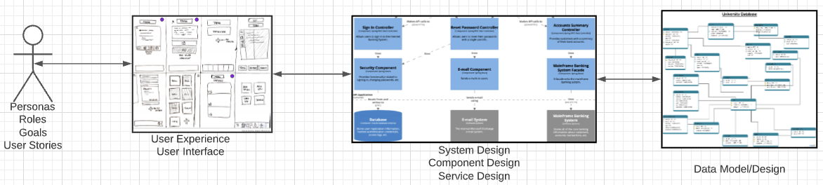
Problem Statement – Modified (Lecture 1 Reminder)
We must build a system that supports ... ... operations in a ... ...
We will design, develop, test and deploy the system iteratively and continuously.
There are four core domains.
The processes are iterative, with continuous extension and details.
We will start implementing various user stories. Implementation requires:
Web UI
Paths
Data model and operations.
In this course,
We focus on the data dimension.
We will get some insight into the other dimensions.

Slide 14
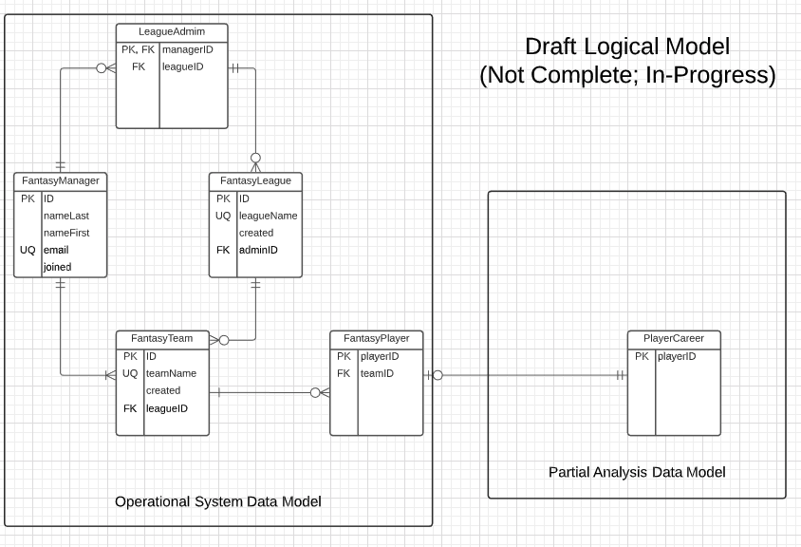
In-Progress Operational System Data Model

Slide 15
Web Application – Operational System
Lahman’s Baseball DB
Fantasy Baseball DB

Slide 16
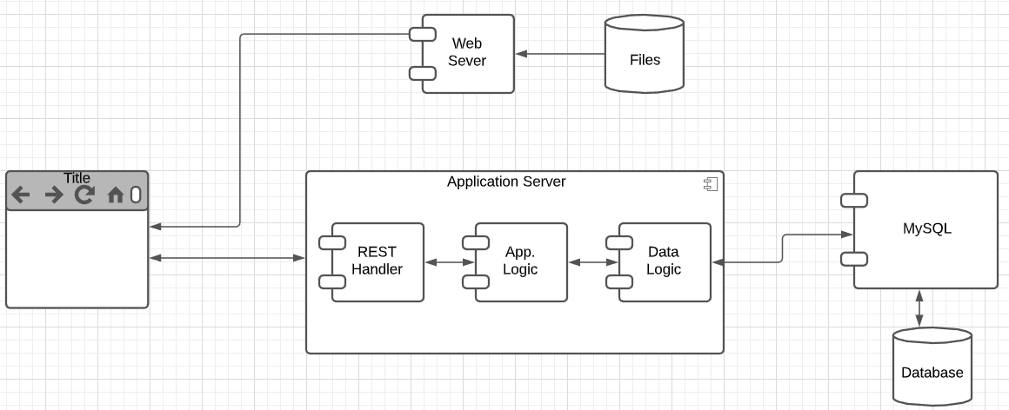
User Story
“In software development and product management, a user story is an informal, natural language description of one or more features of a software system. User stories are often written from the perspective of an end user or user of a system. ” (https://en.wikipedia.org/wiki/User_story)
Example user stories that I need to implement for the operational system:
”As a fantasy team manager, I want to search for players based on career stats.”
“As a fantasy team manager, I want to add a player to my fantasy team.
etc.
I need to implement:
UI
Application logic
Database tables.

Slide 17
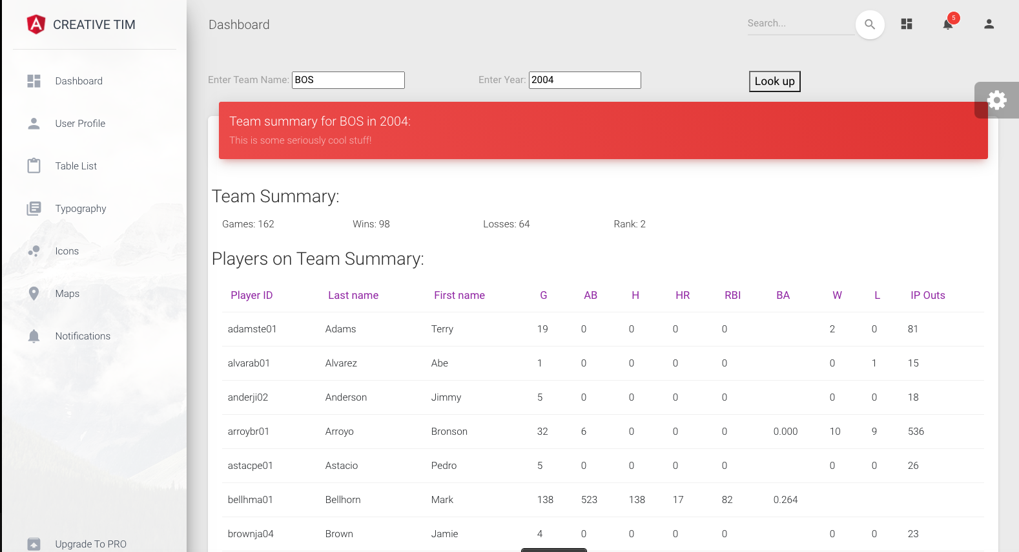
Simple Example
Web Application
MySQL
Two HTTP/REST calls:
GET /api/team_summary?team_id=BOS&year_id=2004
GET /api/teams?teamID=BOS&yearID=2004
Two SQL Queriess:
SELECT to Teams table.
SELECT to team_summary, which is a view. We cover views later.
“As a baseball fan, I want to enter a teamID and yearID and see:
Team wins and losses.
Summary of player performance for players on the team and year.”
Built:
Dashboard page.
REST handlers and application logic.
Database view.
Tracks will build:
Programming: Mix of CRUD and dashboard.
Non-programming: Dashboards, Data transformation.
Will see more details as we move forward.

Slide 18
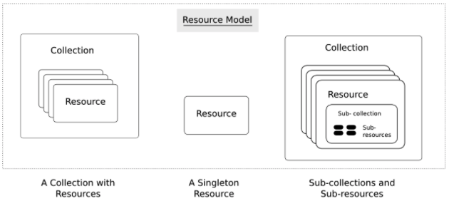
Simple Example – Fantasy Team Resource
https://restful-api-design.readthedocs.io/en/latest/resources.html
Interaction flow is right-to-left in this diagram.
Resources: (https://restful-api-design.readthedocs.io/en/latest/resources.html)
The fundamental concept in any RESTful API is the resource. A resource is an object with a type, associated data, relationships to other resources, and a set of methods that operate on it.
... ... information that describes available resources types, their behavior, and their relationships the resource model of an API. The resource model can be viewed as the RESTful mapping of the application data model.
APIs:
... ... APIs expose functionality of an application or service that exists independently of the API. (DFF comment – the data)
Understanding enough of the important details of the application for which an API is to be created, so that an informed decision can be made as to what functionality needs to be exposed ... ...
Modeling this functionality in an API that addresses all use cases that come up in the real world ... ...

Slide 19
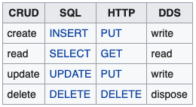
CRUD (https://en.wikipedia.org/wiki/Create,_read,_update_and_delete)
Definitions:
“In computer programming, create, read, update, and delete[1] (CRUD) are the four basic functions of persistent storage.”
“The acronym CRUD refers to all of the major functions that are implemented in relational database applications. Each letter in the acronym can map to a standard Structured Query Language (SQL) statement, Hypertext Transfer Protocol (HTTP) method (this is typically used to build RESTful APIs[5]) or Data Distribution Service (DDS) operation.”
Do not worry about Data Distribution Service.
For our purposes HTTP – REST
Entity Set:
Table in SQL
Collection Resource in REST.
Entity:
Row in SQL
Resource in REST

Slide 20
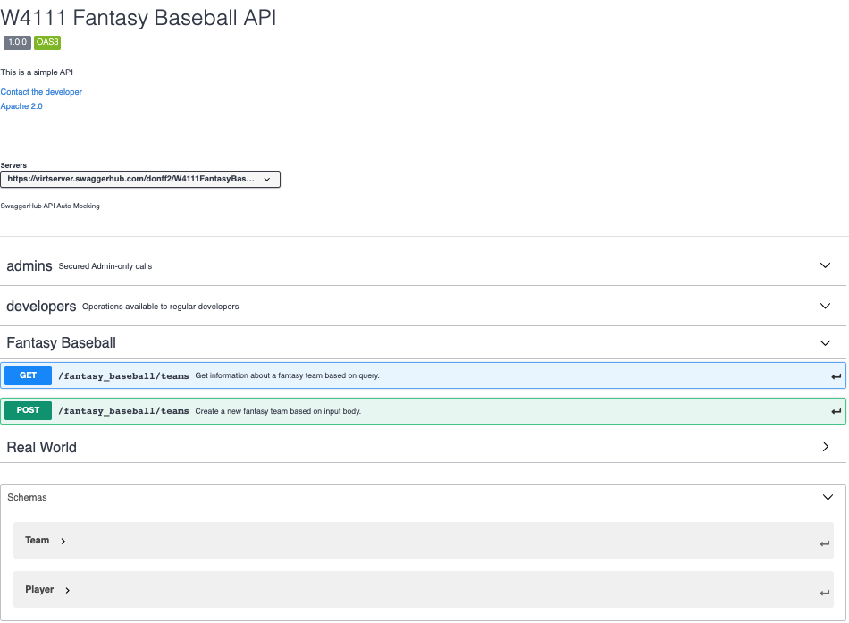
REST API Definition
“A REST API is a way for two computer systems to communicate over HTTP in a similar way to web browsers and servers. Sharing data between two or more systems has always been a fundamental requirement of software development.)
“Like any other architectural style, REST also does have it’s own 6 guiding constraints which must be satisfied if an interface needs to be referred as RESTful.”
Open API Definition
API Tags/Groupings
A resource has
Paths
Methods
Schema (Data Formats)
Sent on POST and PUT
Returned on GET
This material is just FYI and to help with understanding concepts, mapping to DB, ...

Slide 21
Demo and Next Steps
API: https://app.swaggerhub.com/apis/donff2/W4111FantasyBaseball/1.0.0#/
Starter API project:
App (Postman) http://127.0.0.1:5000/api/fantasy_team/BOS20011
Project: ~/Dropbox/Columbia/W4111_S21_New/W4111S21/Projects/FantasyBaseball
Next Steps:
Will commit the template project, sample code and schedule orientation in recitation.
Will try to provide some UI, but this is not a UI class.

Slide 22
Analysis System
22 | COMS W4111_002_2021_1: Lecture 7: ER, Apps, SQL, Projects © Donald F. Ferguson, 2021

Slide 23
Analysis System – Fantasy Baseball Concept
Focus is on the Analysis Data System (Primary Focus):
Data Lake is source data, imported and added to common database/model. (e.g. Lahman Baseball DB)
Analysis data is transformed data suitable for analysis, and analysis results. (e.g. Transformed Lahman’s Data)
Various analysis and processing tools use the data for insight, visualization, etc. (e.g. Jupyter, Pandas)
Analysis and Processing Tools System
Results Reports
Analysis Data System
Data
Transform
And Load Processes
Analysis Data
Transformed for analysis. Analyzed and derived information.
Data Lake
Loaded, unprocessed Original input data.
Data/Schema Transform

Slide 24
Data Lake to Analysis Data
This is a database class. So, the raw data to analysis data is a focus.
Consider the following requirement.
I want to be able to predict a player’s performance relative to salary based on history.
The first step is joining information from several tables, e.g.
Appearances.
Batting.
Pitching.
Fielding. We are not trying to be super accurate about baseball. This is a DB class. We will ignore fielding.
Salary.
We then need to produce a single summary/prediction row. But, this is not as simple as just summing and averaging.
A year’s numbers may be low because the player was injured and did not play many games.
The average is not meaningful. Over their career, player’s get better and then worse. We want to use averages for historical players but trends for active players.
Salary data is missing. Average salary changed over time and we need to normalize.
Absolute numbers do not matter. What matters is relative performance to other players.
Let’s just do a very simple example. Career summary of annual performance relative to averages.
We will not do these now.
I will do during other lectures and as I do my project.

Slide 25
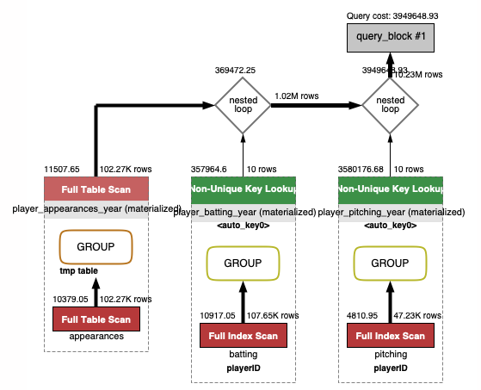
Task 1 – Player, Year Summary
with player_basic as ( select playerID, nameLast, nameFirst, bats, throws from people), player_appearances_year as ( select playerid, yearid, sum(g_all) as app_g_all, sum(gs) as app_g_s, sum(g_defense) as app_g_defense, sum(g_p) as app_g_p, sum(g_c) as app_g_c, sum(g_1b) as app_g_1b, sum(g_2b) as app_g_2b, sum(g_3b) as app_g_3b, sum(g_ss), sum(g_lf) as app_g_lf, sum(g_cf) as app_g_cf, sum(g_rf) as app_g_rf from appearances group by playerid, yearid ), player_batting_year as ( select playerid, yearid, sum(g) as bat_g, sum(g_batting) as g_batting, sum(ab) as bat_ab, sum(r) as bat_r, sum(h) bat_h, sum(h-`2b`-`3b`-hr) as bat_1, sum(`2b`) as bat_2, sum(`3b`) as bat_3, sum(hr) as bat_hr, sum(rbi) as bat_rbi, sum(sh) as bat_sh, sum(sf) as bat_sf, sum(`2b`) as b2, sum(`3b`) as b3, sum(hr) as hr, sum(bb) as bb from batting group by playerid, yearid ), player_pitching_year as ( select playerid, yearid, sum(w) as p_w, sum(l) as p_l, sum(g) as p_g, sum(IPOuts) as p_IPOuts, sum(SV) as p_SV, sum(h) as p_h, sum(hr) as p_hr, sum(bb) as p_bb, sum(er) as p_er from pitching group by playerid, yearid ) select * from (select * from player_appearances_year left join player_batting_year using(playerid, yearid)) as x left join player_pitching_year using(playerid, yearid)
The core of the data lake are the raw tables.
We clearly do not want to run this query every time we decide to examine and choose players.
Task 1 adds a processed, “wide flat” table to the data lake for subsequent processing.

Slide 26
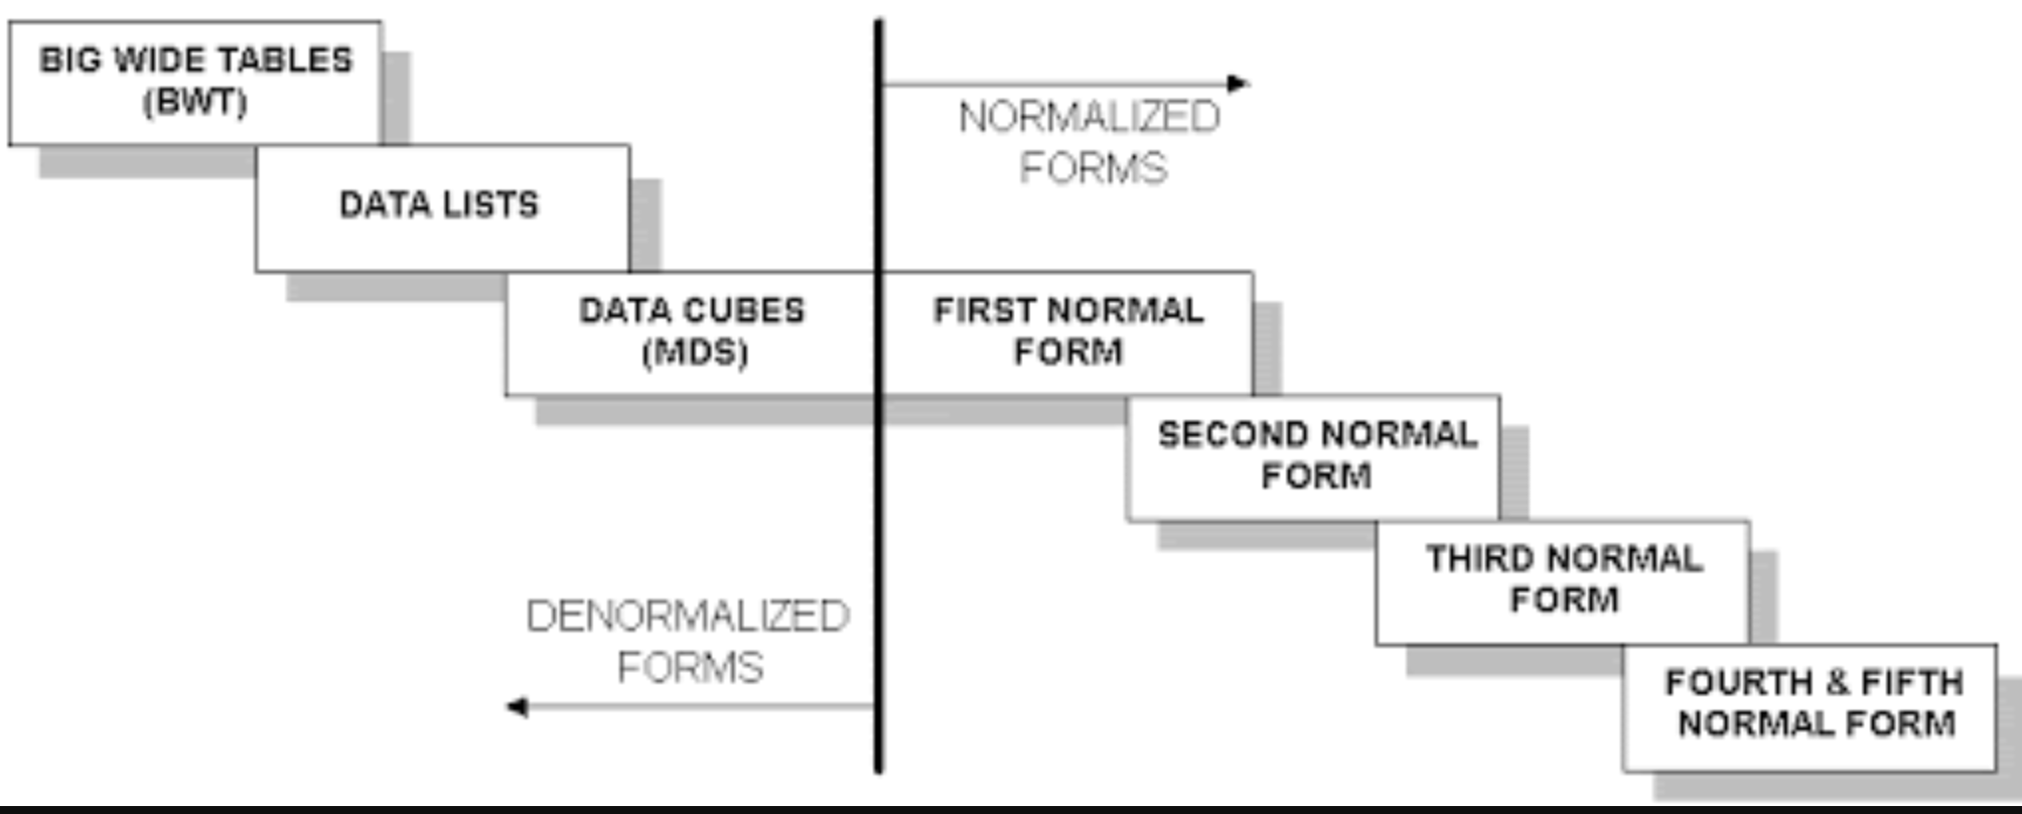
Wide Flat Tables
Good for Integrity
Good for Query
Improve query performance by precomputing and saving:
JOINs
Aggregation
Derived/computed columns
One of the primary strength of the relational model is maintaining “integrity” when applications create, update and delete data. This relies on:
The core capabilities of the relational model, e.g. constraints.
A well-design database (We will cover a formal definition – “normalization” in more detail later.
Data models that are well designed for integrity are very bad for read only analysis queries. We will build and analyze wide flat tables as part of the analysis tasks in HW3, HW4 as projects.

Slide 27
External Information
Analysis projects often include data from multiple sources and domains.
Consider an example:
Building the best “fantasy baseball team” is an optimization problem.
Find the “best” players at the “lowest price (salary).”
We have a few problems:
We must normalize old values to modern (constant) dollars.
There has been a general, upward trend in salaries. What matters is a player’s salary relative to the average salary for a year.
We have “missing” salaries:
No information before 1985.
Missing some entries in the range 1985-present.
We will just do a hypothetical normalization right now.

Slide 28
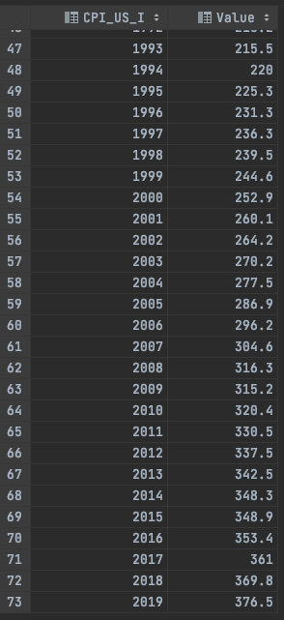
Normalize the Value of the Dollar
“A constant dollar is an adjusted value of currency used to compare dollar values from one period to another.” (Investopedia)
“To accurately compare income over time, users should adjust the summary measures (medians, means, etc.) for changes in cost of living (prices).” (US Census).
This is not an MBA or economics class. We are just going to do something hypothetical and simple.
“To use the CPI-U-RS to inflation adjust an income estimate from 1995 dollars to 2019 dollars, multiply the 1995 estimate by the CPI-U-RS from 2019 (376.5) divided by the CPI-U-RS from 1995 (225.3)” (US Census)
A 1995 salary of $100,000 is $ (376.5 / 225.3)*100000 = $167110.
We will compute the inflation adjusted, average annual salary.

Slide 29
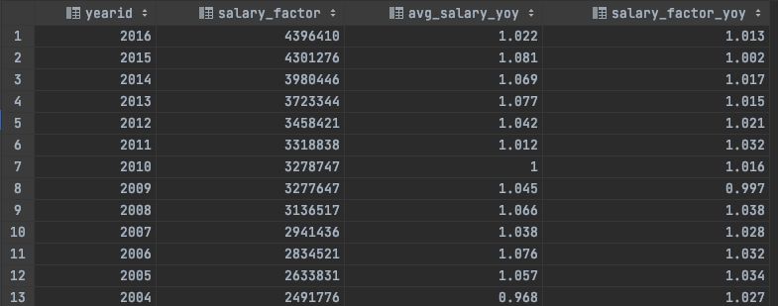
Hypothetical Normalization
with annual_average_salary as ( select yearid, round(avg(salary),0) as avg_salary from lahmansbaseballdb.salaries group by yearid ), normalized_averages as ( select yearid, avg_salary, cpi.value as salary_factor, round((avg_salary / cpi.value), 0) as normalized_avg_salary from annual_average_salary join cpi on yearid=cpi.CPI_US_I ), averages_and_yoy as ( select a.yearid, a.avg_salary, a.salary_factor, b.avg_salary as prior_avg_salary, b.salary_factor as prior_salary_factor from normalized_averages as a join normalized_averages as b on a.yearid=b.yearid+1 ) select yearid, avg_salary salary_factor, round(avg_salary/prior_avg_salary,3) avg_salary_yoy, round(salary_factor/prior_salary_factor,3) as salary_factor_yoy from averages_and_yoy order by yearid desc;
I doubt very much that I got this correct.
But you get the basic idea:
Process core data from the domain.
Bring in external information to adjust.
Bring this together with the larger data, in this case to be able to talk about player performance relative to salary.

Slide 30
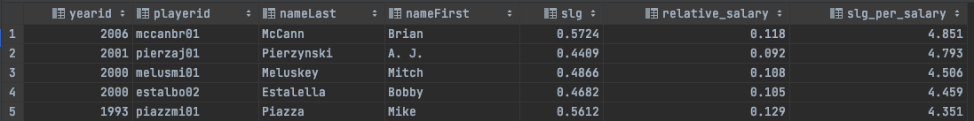
Hypothetical Player Choice
Scenario:
I need a catcher for my team.
I want to find the “best 5 batting catchers by year.”
I measure batting performance by slugging percentage.
I want to normalize salary relative averages and CPI.
I do not want absolute best. I want best price performance, e.g. (slugging percentage)/(normalized_salary)
Switch to Notebook.

Slide 31
Optimal Price/Performance Catcher
with annual_batting_performance_salary as ( select playerid, yearid, app_g_c, (bat_h / if(bat_ab = 0, NULL, bat_ab)) as bat_avg, ((bat_h + bb) / (bat_ab + bb)) as bat_obp, ((bat_1 + bat_2 * 2 + bat_3 * 3 + bat_hr * 4) / if(bat_ab = 0, NULL, bat_ab)) as slg, salary from player_performance_year join (select playerid, yearid, avg(salary) as salary from lahmansbaseballdb.salaries group by playerid, yearid) as a using (playerid, yearid) where bat_ab >= 100 ), normalized_salary_batting_performance as ( select yearid, playerid, bat_obp, slg, app_g_c, round(salary/normalized_salary_averages.salary_factor,3) as relative_salary from annual_batting_performance_salary join normalized_salary_averages using(yearid) ) select yearid, playerid, nameLast, nameFirst, slg, relative_salary, round(slg/relative_salary,3) as slg_per_salary from normalized_salary_batting_performance join lahmansbaseballdb.people using(playerid) where app_g_c > 100 order by slg_per_salary desc limit 5;
If I got that correct, it was a miracle.
The purpose wasn’t to win at Fantasy Baseball.
Just giving a feel for the types of things that
Will happen in HW3, HW4 (Project) in
Analysis Subsystem
The non-programming track will use tools:
Jupyter
SciKit
... ...
To analyze.
This is a database track. So, the programming track will also get some experience.
Process for both tracks:
You can pick your own data and domain
Or follow along with me.
There will be a set of criteria that you have to meet for each of HW4 and HW4, measure in:
Data model complexity.
Complexity of operations on the data.

Slide 32
Complex Examples Columbia Courses, Sections, Enrollments (Part II – Students and Faculty)
32 | COMS W4111_002_2021_1: Lecture 5: Advanced SQL and Projects © Donald F. Ferguson, 2021

Slide 33
IsA, Inheritance, Generalization, Specialization
33 | COMS W4111_002_2021_1: Lecture 5: Advanced SQL and Projects © Donald F. Ferguson, 2021

Slide 34
Faculty and Students
ER Notation
We modelled course.
To enroll students in courses, we need ...
Sections
Faculty
Students
Let’s focus on the “people aspect.” We have
People
A Faculty is a People.
A Student is a People.
“In object-oriented programming, inheritance is the mechanism of basing an object or class upon another object (prototype-based inheritance) or class (class-based inheritance), retaining similar implementation. Also defined as deriving new classes (sub classes) from existing ones such as super class or base class and then forming them into a hierarchy of classes.”
This is a new type of relationship in ER modeling.

Slide 35
Specialization
Top-down design process; we designate sub-groupings within an entity set that are distinctive from other entities in the set.
These sub-groupings become lower-level entity sets that have attributes or participate in relationships that do not apply to the higher-level entity set.
Depicted by a triangle component labeled ISA (e.g., instructor “is a” person).
Attribute inheritance – a lower-level entity set inherits all the attributes and relationship participation of the higher-level entity set to which it is linked.

Slide 36
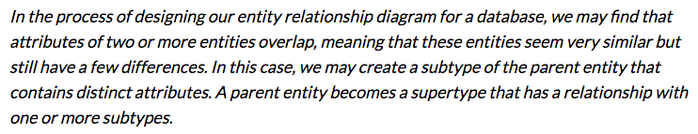
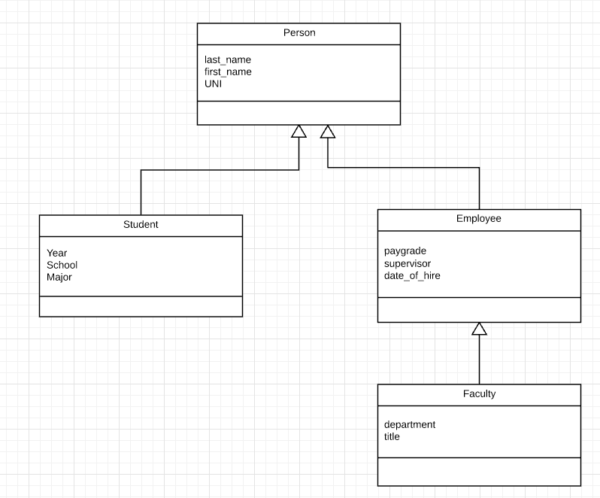
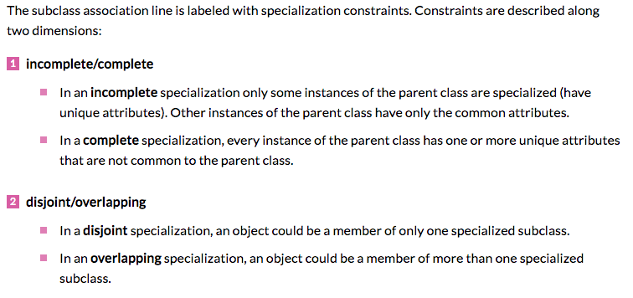
Inheritance, IsA, Specialization
Are all employees faculty?
Can students also be employees?
http://www.vertabelo.com/blog/technical-articles/inheritance-in-a-relational-database
36 | W4111_02_F20: Introduction to Databases – Lecture 6

Slide 37
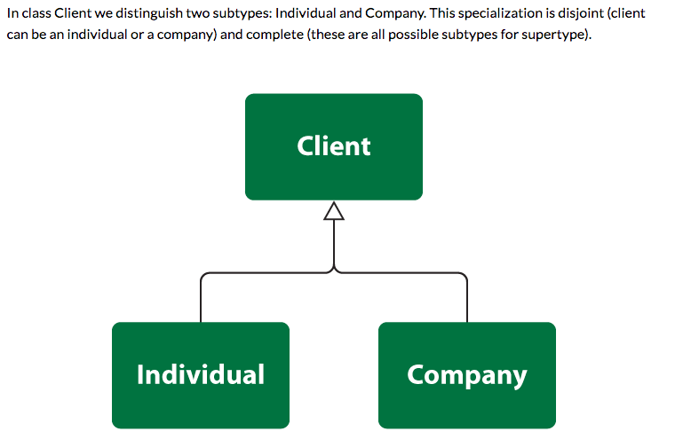
Simpler Example
37 | W4111_02_F20: Introduction to Databases – Lecture 6

Slide 38
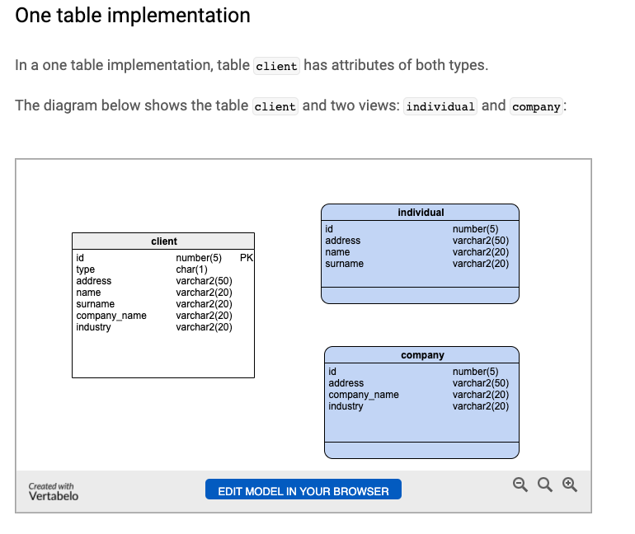
One Table Implementation
Views
Tables
38 | W4111_02_F20: Introduction to Databases – Lecture 6

Slide 39
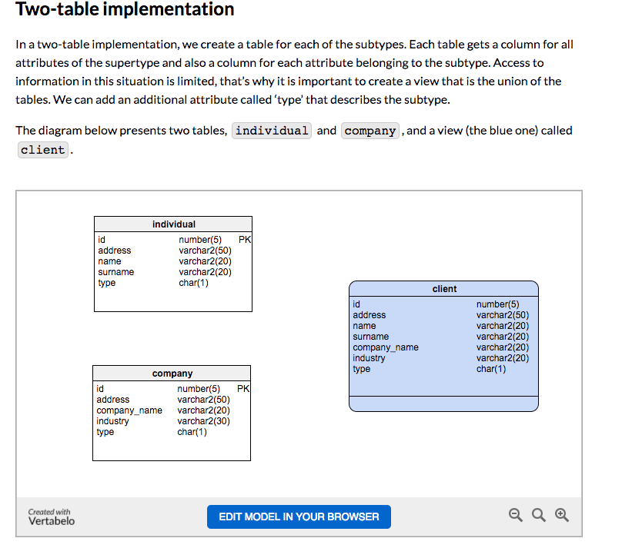
Two Table Implementation
View
Tables
39 | W4111_02_F20: Introduction to Databases – Lecture 6

Slide 40
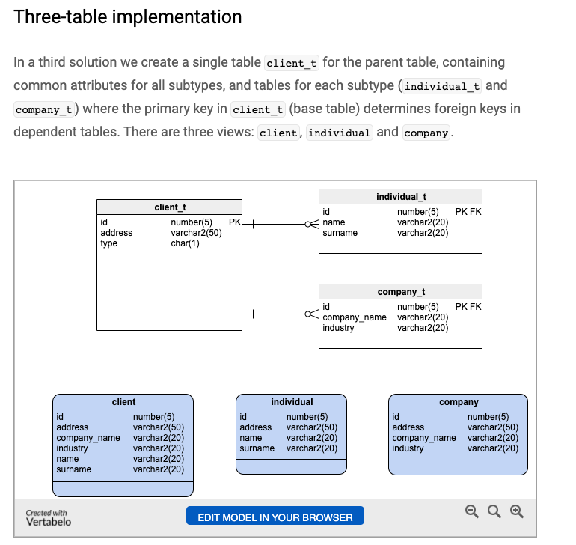
Two Table Implementation
Tables
Views
40 | W4111_02_F20: Introduction to Databases – Lecture 6

Slide 41
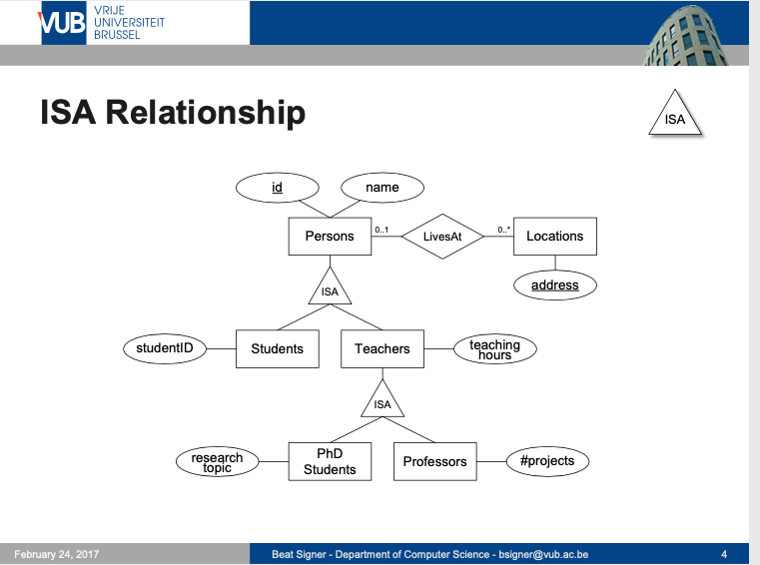
Modeling
41 | W4111_02_F20: Introduction to Databases – Lecture 6

Slide 42
ER vs. UML Class Diagrams
ER Diagram Notation
Equivalent in UML
I use this approach in Crow’s Foot Notation but that is not standard.
* Generalization can use merged or separate arrows independent
of disjoint/overlapping

Slide 43
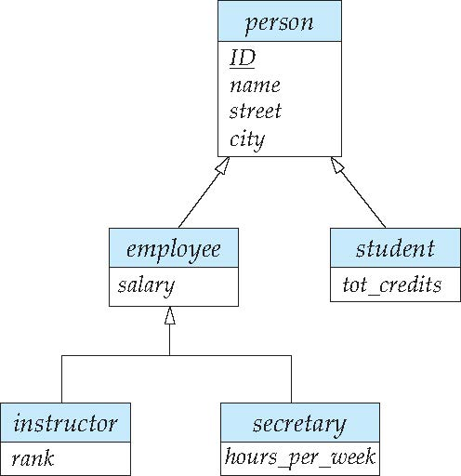
Specialization Example
Overlapping – employee and student
Disjoint – instructor and secretary
Total and partial

Slide 44
Generalization
A bottom-up design process – combine a number of entity sets that share the same features into a higher-level entity set.
Specialization and generalization are simple inversions of each other; they are represented in an E-R diagram in the same way.
The terms specialization and generalization are used interchangeably.

Slide 45
Completeness constraint
Completeness constraint -- specifies whether or not an entity in the higher-level entity set must belong to at least one of the lower-level entity sets within a generalization.
total: an entity must belong to one of the lower-level entity sets
partial: an entity need not belong to one of the lower-level entity sets

Slide 46
Completeness constraint (Cont.)
Partial generalization is the default.
We can specify total generalization in an ER diagram by adding the keyword total in the diagram and drawing a dashed line from the keyword to the corresponding hollow arrow-head to which it applies (for a total generalization), or to the set of hollow arrow-heads to which it applies (for an overlapping generalization).
The student generalization is total: All student entities must be either graduate or undergraduate. Because the higher-level entity set arrived at through generalization is generally composed of only those entities in the lower-level entity sets, the completeness constraint for a generalized higher-level entity set is usually total

Slide 47
Worked Example
47 | COMS W4111_002_2021_1: Lecture 5: Advanced SQL and Projects © Donald F. Ferguson, 2021

Slide 48
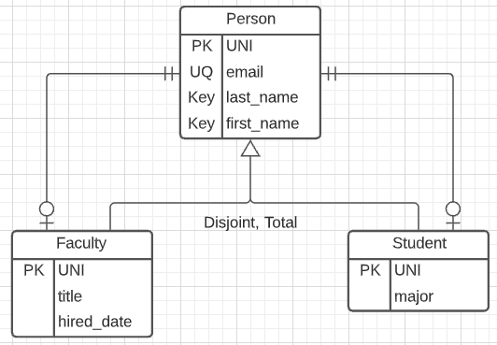
Person, Faculty, Student
Model
Complete:
Every entity is a Faculty or a Student.
There are no entities that are just Person.
Disjoint:
Either a Faculty or a Student
But not both.
3-Table solution.
Relationships:
Faculty-Person is one-to-one.
Student-Person is one-on-one.
Person is exactly 1.
Faculty or Student is 0-1.
There is no easy way to handle the fact that one of Faculty or Student must exist.

Slide 49
The UNI
The UNI creates some interesting challenges:
A given UNI is in two tables: Person, Faculty or Person, Student.
A given UNI can only be in the Faculty table or the Student table.
My algorithm for generating the UNI is:
Prefix: Concatenate
First two characters of first name.
First two characters of the last name
Suffix: Add 1 to the number of existing UNIs with the same prefix.
Concatenate the prefix and suffix.
Immutable: Cannot change.
Implementing the semantics in applications accessing the data is error prone.
The more places you implement something, the more places you can mess up.
You have to find all the apps and change them if the logic changes.
So, we are going to implement using a function and trigger.

Slide 50
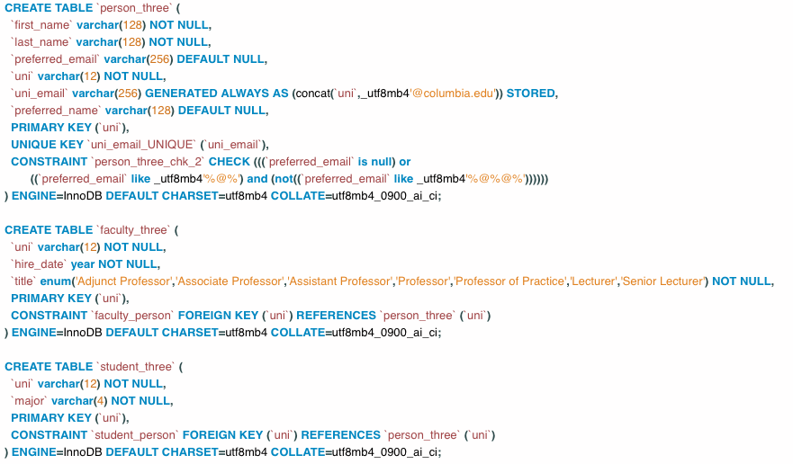
Table Definitions

Slide 51
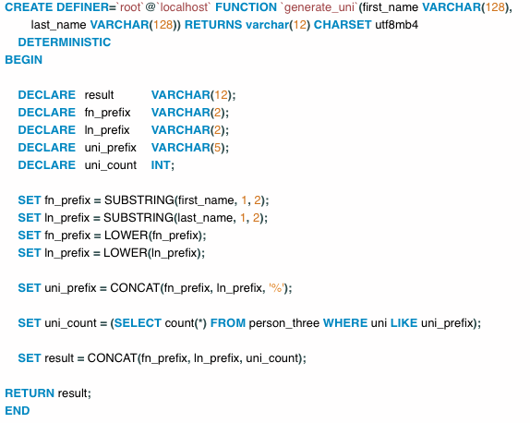
Function
Switch to notebook.

Slide 52
Design Pattern for Inheritance Integrity
So far, we have created:
A three-table solution to a simple inheritance design problem.
Core elements are:
Function for computing UNIs.
A view to query the concrete class without exposing inheritance.
A procedure to create one of the concrete classes and the base classes.
But,
We would still need to implement the update and delete stored procedures to ensure encapsulation and integrity. This prevents users from corrupting the data by removing the need to understand the model and write SQL scripts.
Implement a Trigger that rejects changing the UNI. Let’s do that now.
But, what if someone mistakenly uses the tables directly with SQL statements. That would still cause integrity problems.
We can use identity, roles and permissions.

Slide 53
Security
53 | COMS W4111_002_2021_1: Lecture 5: Advanced SQL and Projects © Donald F. Ferguson, 2021

Slide 54
Security Concepts (Terms from Wikipedia)
Definitions:
“A (digital) identity is information on an entity used by computer systems to represent an external agent. That agent may be a person, organization, application, or device.”
“Authentication is the act of proving an assertion, such as the identity of a computer system user. In contrast with identification, the act of indicating a person or thing's identity, authentication is the process of verifying that identity.”
“Authorization is the function of specifying access rights/privileges to resources, ... More formally, "to authorize" is to define an access policy. ... During operation, the system uses the access control rules to decide whether access requests from (authenticated) consumers shall be approved (granted) or disapproved.
“Within an organization, roles are created for various job functions. The permissions to perform certain operations are assigned to specific roles. Members or staff (or other system users) are assigned particular roles, and through those role assignments acquire the permissions needed to perform particular system functions.”
“In computing, privilege is defined as the delegation of authority to perform security-relevant functions on a computer system. A privilege allows a user to perform an action with security consequences. Examples of various privileges include the ability to create a new user, install software, or change kernel functions.”
SQL and relational database management systems implementing security by:
Creating identities and authentication policies.
Creating roles and assigning identities to roles.
Granting and revoking privileges to/from roles and identities.

Slide 55
Authorization
We may assign a user several forms of authorizations on parts of the database.
Read - allows reading, but not modification of data.
Insert - allows insertion of new data, but not modification of existing data.
Update - allows modification, but not deletion of data.
Delete - allows deletion of data.
Each of these types of authorizations is called a privilege. We may authorize the user all, none, or a combination of these types of privileges on specified parts of a database, such as a relation or a view.

Slide 56
Authorization (Cont.)
Forms of authorization to modify the database schema
Index - allows creation and deletion of indices.
Resources - allows creation of new relations.
Alteration - allows addition or deletion of attributes in a relation.
Drop - allows deletion of relations.

Slide 57
Authorization Specification in SQL
The grant statement is used to confer authorization
grant <privilege list> on <relation or view > to <user list>
<user list> is:
a user-id
public, which allows all valid users the privilege granted
A role (more on this later)
Example:
grant select on department to Amit, Satoshi
Granting a privilege on a view does not imply granting any privileges on the underlying relations.
The grantor of the privilege must already hold the privilege on the specified item (or be the database administrator).

Slide 58
Privileges in SQL
select: allows read access to relation, or the ability to query using the view
Example: grant users U₁, U₂, and U₃ select authorization on the instructor relation:
grant select on instructor to U₁, U₂, U₃
insert: the ability to insert tuples
update: the ability to update using the SQL update statement
delete: the ability to delete tuples.
all privileges: used as a short form for all the allowable privileges

Slide 59
Revoking Authorization in SQL
The revoke statement is used to revoke authorization.
revoke <privilege list> on <relation or view> from <user list>
Example:
revoke select on student from U₁, U₂, U₃
<privilege-list> may be all to revoke all privileges the revokee may hold.
If <revokee-list> includes public, all users lose the privilege except those granted it explicitly.
If the same privilege was granted twice to the same user by different grantees, the user may retain the privilege after the revocation.
All privileges that depend on the privilege being revoked are also revoked.

Slide 60
Roles
A role is a way to distinguish among various users as far as what these users can access/update in the database.
To create a role we use:
create a role <name>
Example:
create role instructor
Once a role is created we can assign “users” to the role using:
grant <role> to <users>

Slide 61
Roles Example
create role instructor;
grant instructor to Amit;
Privileges can be granted to roles:
grant select on takes to instructor;
Roles can be granted to users, as well as to other roles
create role teaching_assistant
grant teaching_assistant to instructor;
Instructor inherits all privileges of teaching_assistant
Chain of roles
create role dean;
grant instructor to dean;
grant dean to Satoshi;

Slide 62
Authorization on Views
create view geo_instructor as (select * from instructor where dept_name = 'Geology');
grant select on geo_instructor to geo_staff
Suppose that a geo_staff member issues
select * from geo_instructor;
What if
geo_staff does not have permissions on instructor?
Creator of view did not have some permissions on instructor?

Slide 63
Other Authorization Features
references privilege to create foreign key
grant reference (dept_name) on department to Mariano;
Why is this required?
transfer of privileges
grant select on department to Amit with grant option;
revoke select on department from Amit, Satoshi cascade;
revoke select on department from Amit, Satoshi restrict;
And more!
Note:
Like in many other cases, SQL DBMS have product specific variations.
Switch to notebook.

